Slide 1
Unit Testing Workshop
Sebastiaan Vandekerkhove

Slide 2
What are we learning
What’s a unit test?
What’s a good unit test?
How to write unit tests for .NET?
How to write unit tests for JS?
Unit tests and refactoring
Cool tricks and tips

Slide 3
Files
https://github.com/Valthek/UnitTesting

Slide 4
So what’s a unit test?
Fast
In-Memory
Idempotent
Automatic
Repeatable

Slide 5
But why?
Finding bugs
Keep your co-workers from breaking your code
Improve code quality and readability

Slide 6
A word on TDD
Cool

Slide 7
A few more words on TDD
Write tests first, then write code that passes those tests
More initial setup, potentially huge payoff
Not a way of life, but a strategy
Very useful when writing unknown code
100% TDD is hard to achieve
Not a panacea

Slide 8
Let’s do some actual testing
Use xUnit
Start Simple

Slide 9
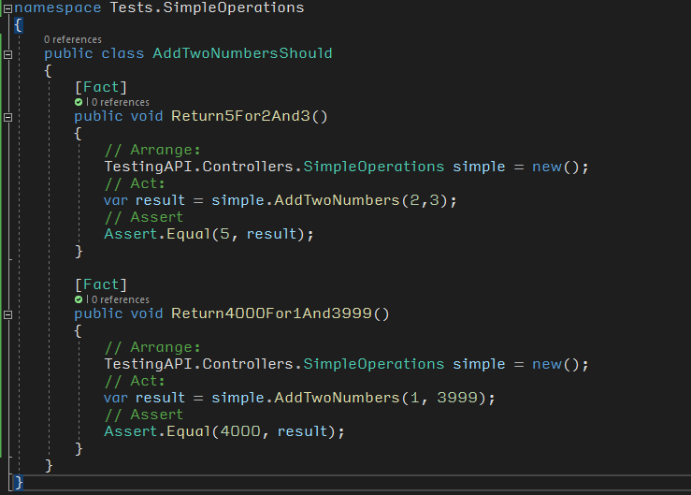
Example Test 1

Slide 10
Unit Testing Naming Conventions
Descriptive naming
{FunctionToBeTested}Should for filename
Name of test tells you what should happen
Ex: ShouldReturn4For2

Slide 11
Testing Best Practices - AAA
A: Arrange – Set up your test
A: Act – Execute the code
A: Assert – See if the end result is what you expect

Slide 12
Getting Data to our test
Simplify Test writing
Use [Theory]
Inline data via [InlineData($Data)]

Slide 13
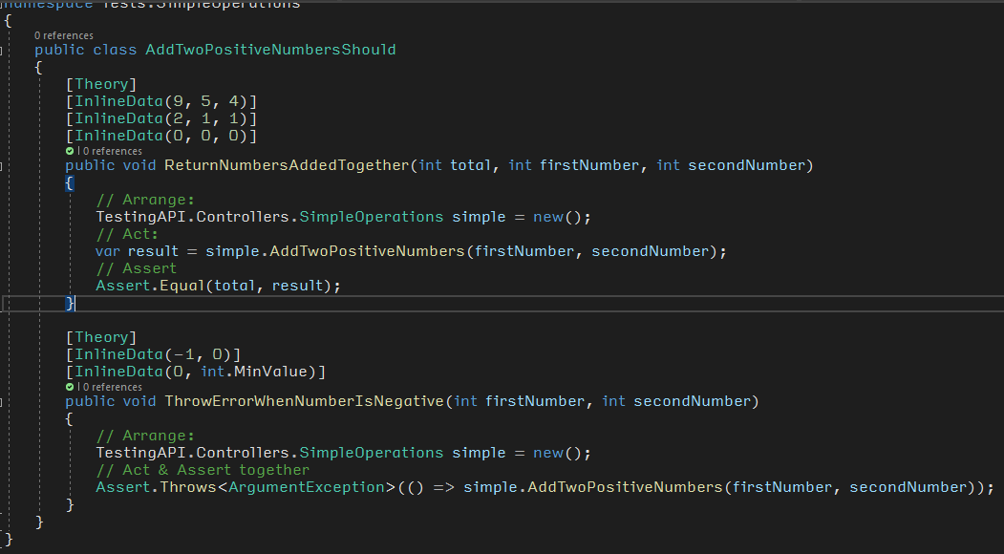
Example Test 2

Slide 14
Getting Data to our test
More options
Generator properties via [MemberData(nameof($AnyIEnnumerable))]

Slide 15
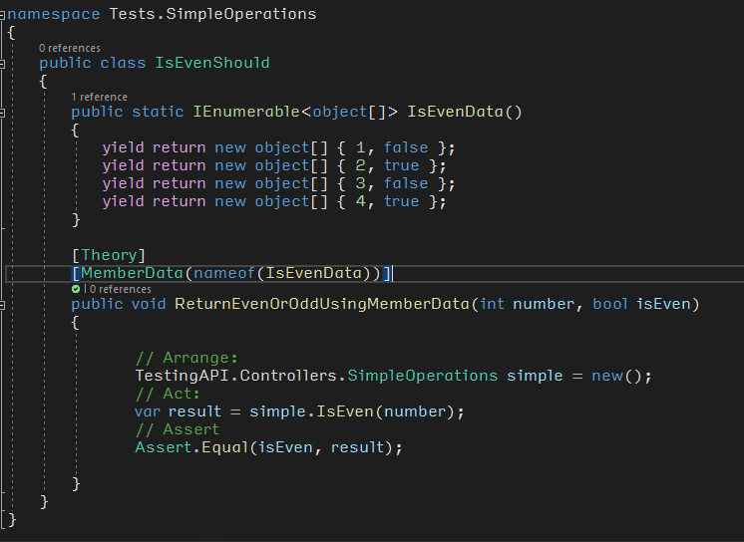
Example test 3

Slide 16
More options
External Class via [ClassData(typeof($DataObject))]
Create a class to produce data
Use Add to add data to your dataset

Slide 17
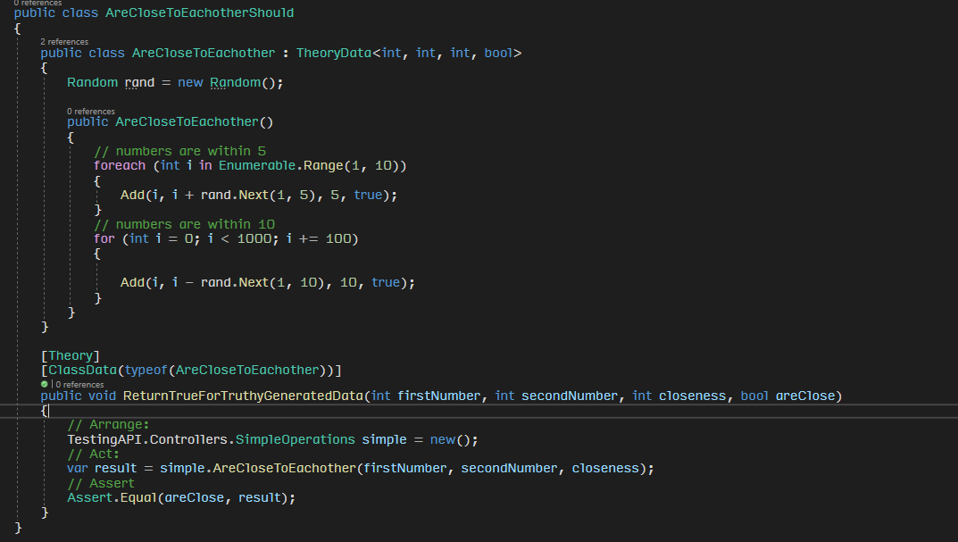
Example test 4

Slide 18
Use, Reduce, Reuse
Collection Fixtures to share expensive setup
Use ICollectionFixture<type> and the [CollectionDefinition] tag
Make them IDisposable
Reuse class with [Collection] tag

Slide 19
A bit of note-taking
Outputhelper
Put some logs in your tests

Slide 20
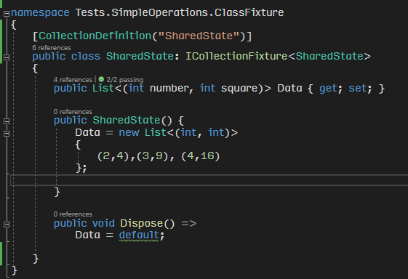
A collection, shared for different runs

Slide 21
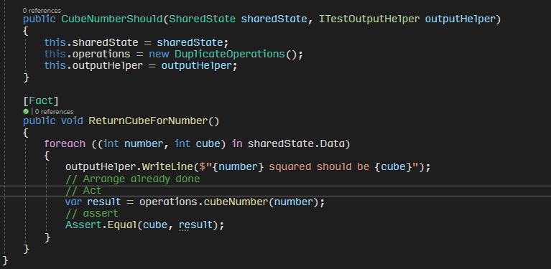
Using the collection

Slide 22
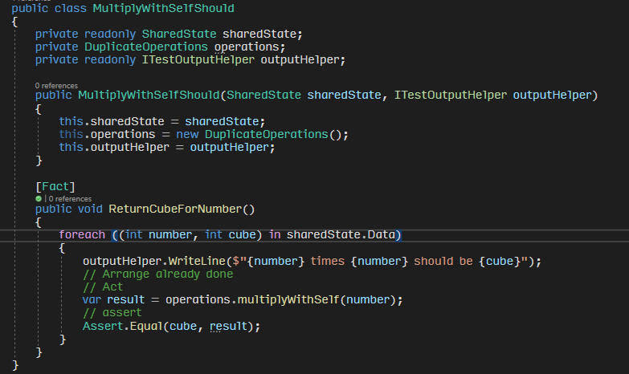
Using it twice!

Slide 23
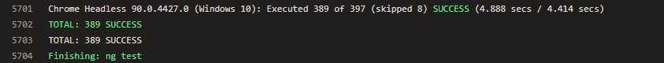
Why we should think about performance, an example

Slide 24
What we need is SPEED!
xUnit runs tests in parallel if they’re in different classes
Tests in the same class run sequential
Tests in the same Collection run sequential
Make your classes thread safe

Slide 25
That’s the basics
Let’s actually make unit tests good

Slide 26
SOLID in de context van Testing
Pop Quiz!

Slide 27
Single Responsibility in Unit Testing
Single responsibility means small classes
Small classes are easy to test
Small classes aren’t very complicated
Small classes make my life easy

Slide 28
Open/Closed Principle in Unit Testing
Entities that are closed for modification have an upper bound to tests
Interfaces make testing easier

Slide 29
Liskov Substitution in Unit Testing
All existing tests should work for derived classes
Copy the suckers, make sure you didn’t mess up (bonus code coverage)

Slide 30
Interface Segregation in Unit Testing
Splitting interfaces into smaller chunks makes them easier to test
See: Everything good I said about Single Responsibility

Slide 31

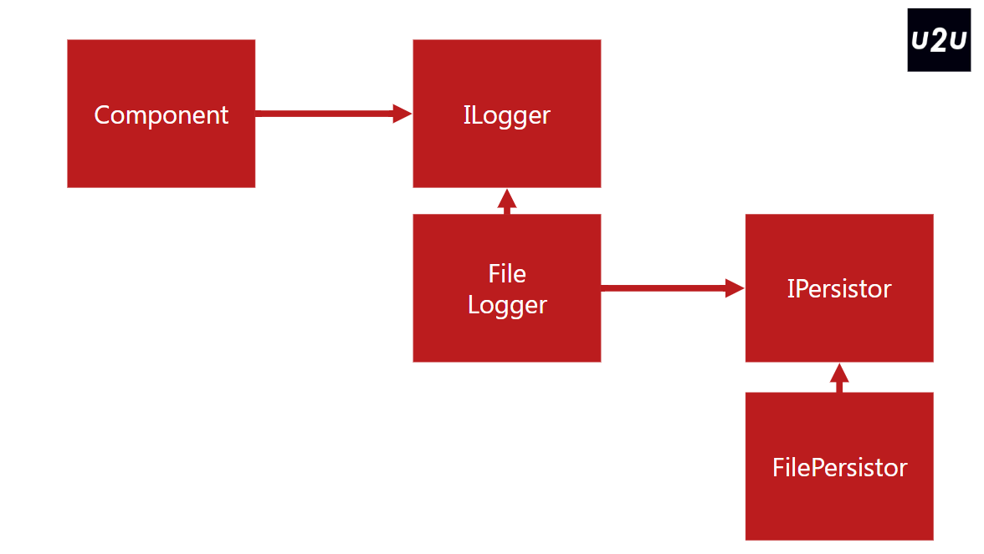
Dependency Inversion in Unit Testing
Dependency Inversion lets us do Dependency Injection
Dependency Injection makes Mocking and Fakes much easier

Slide 32
Tight Coupling makes testing hard
Deep, tight coupling makes testing hard to predict
Chains of Coupling make for lots of side-effects
Just don’t do it

Slide 33
Faking it: A simple guide
Lots of ways to fake things during testing

Slide 34
Dummy
Sometimes we just need to fill a list
Buts to fill seats
Example: list of empty objects

Slide 35
Fake
Implemented code
Shortcut for complex things
Example: In-memory list instead of DB

Slide 36
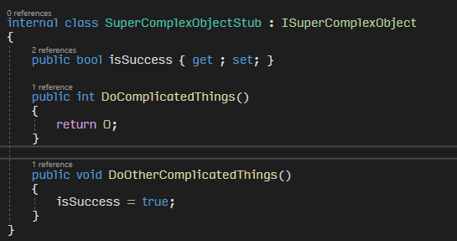
Stub
Fake specific code
Useful in TDD or early development
Predictable response
Example:

Slide 37
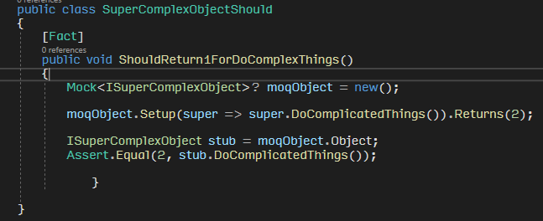
Stubs met Moq

Slide 38
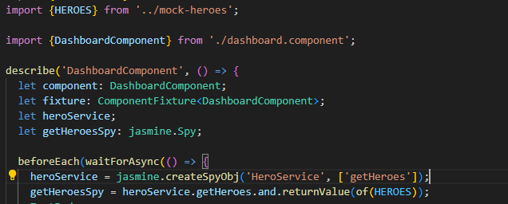
Mock
Intercept calls and verify content
Return pre-programmed response
Verify functionality used
Example:

Slide 39
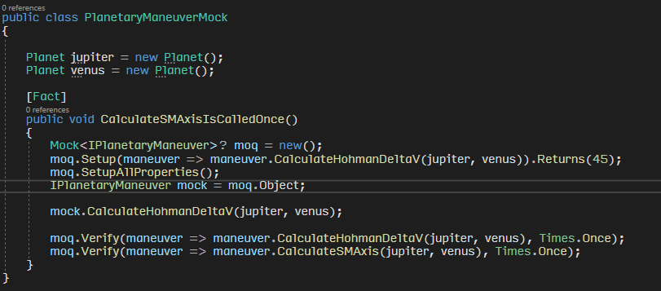
Mocks with Moq
Intercept calls, fake data, check if calls were called

Slide 40
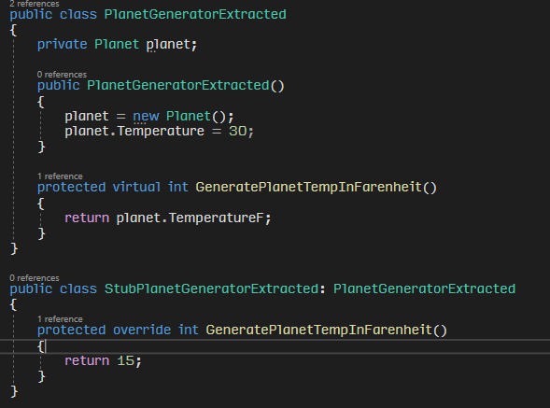
Extract and Override Pattern
How to replace existing bad code with equally bad testable code
Use this when it’s hard to extract a closely coupled class

Slide 41
Testing Javascript and Angular specifically
Basically, the same as testing C#
Different library, different syntax, same general idea
the CLI generates test files automatically

Slide 42
Testing Frameworks
Lots of them
Mocha
Qunit
Jasmine
etc

Slide 43
Jasmine & Karma
Jasmine is one of the more popular Angular Testing frameworks
Karma runs the tests

Slide 44
Mocks - Spies
Mocks in Jasmine are called Spies
Check if a function was called
Fake output
Check input
Prevent function from executing

Slide 45
Common testable functions
Lots of (good) libraries have pre-made mocks
Ex: HttpClientTestingModule for angular mocks HTTP calls

Slide 46
A few more thoughts on testing
AKA: that part where Bas goes off the rails

Slide 47
CI/CD
If you have CI/CD automation set up, have it set up so it automatically runs your tests
All unit tests pass should be part of your DoD

Slide 48
Code Coverage
100% code coverage is a myth
Perfect is the enemy of good enough
More than last week is usually good enough

Slide 49
The 80-20 rule and how to abuse it
80% of your time will be spent on 20% of your code
80% of your CPU cycles will be spent on 20% of your code
If nothing else, test that 20%
Use existing analysis or usage statistics to identify commonly used code

Slide 50
Entomology (The study of Bugs)
When you encounter a bug, write a test to reproduce that behavior
Bugs are sneaky and can come back unexpectedly
Write negative tests, not just positive tests

Slide 51
Confirmation bias and you
A quick game: Guess the rule
Guesses must contain 3 numbers only
I know the rule
Find the rule by deriving the rule from your guesses

Slide 52
The rule
Literally any 3 whole numbers

Slide 53
Negative Tests
Writing tests to test for breaking scenarios
Think of ways your code could break and test that
Example:
ValidatePassword(string Password)
ValidatePasswordShould.ReturnFalseForEmptyString() ValidatePasswordShould.ReturnFalseForNull() ValidatePasswordShould.ReturnFalseForOnlySpecialCharacters()

Slide 54
That’s all folks

